Slide 1
HOW TO GUIDE - DIVORCES
Part A – Joint Application for Divorce (green slides)
Part B – Sole Application for Divorce (yellow slides)

Slide 2
Difference between a Joint Application for Divorce and a Sole Application for Divorce
You can apply for a divorce by yourself (Sole Application) or together with the other party (Joint Application).
Joint Applications need to be signed by both parties. If your ex-spouse won’t agree to signing a Joint Application for Divorce, you can file a Sole Application for Divorce without their consent. However, if you file a Sole Application, you will need to arrange for your ex-spouse to be served with your Application and file proof of service with the Court.

Slide 3
PART A
Joint Application for Divorce

Slide 4
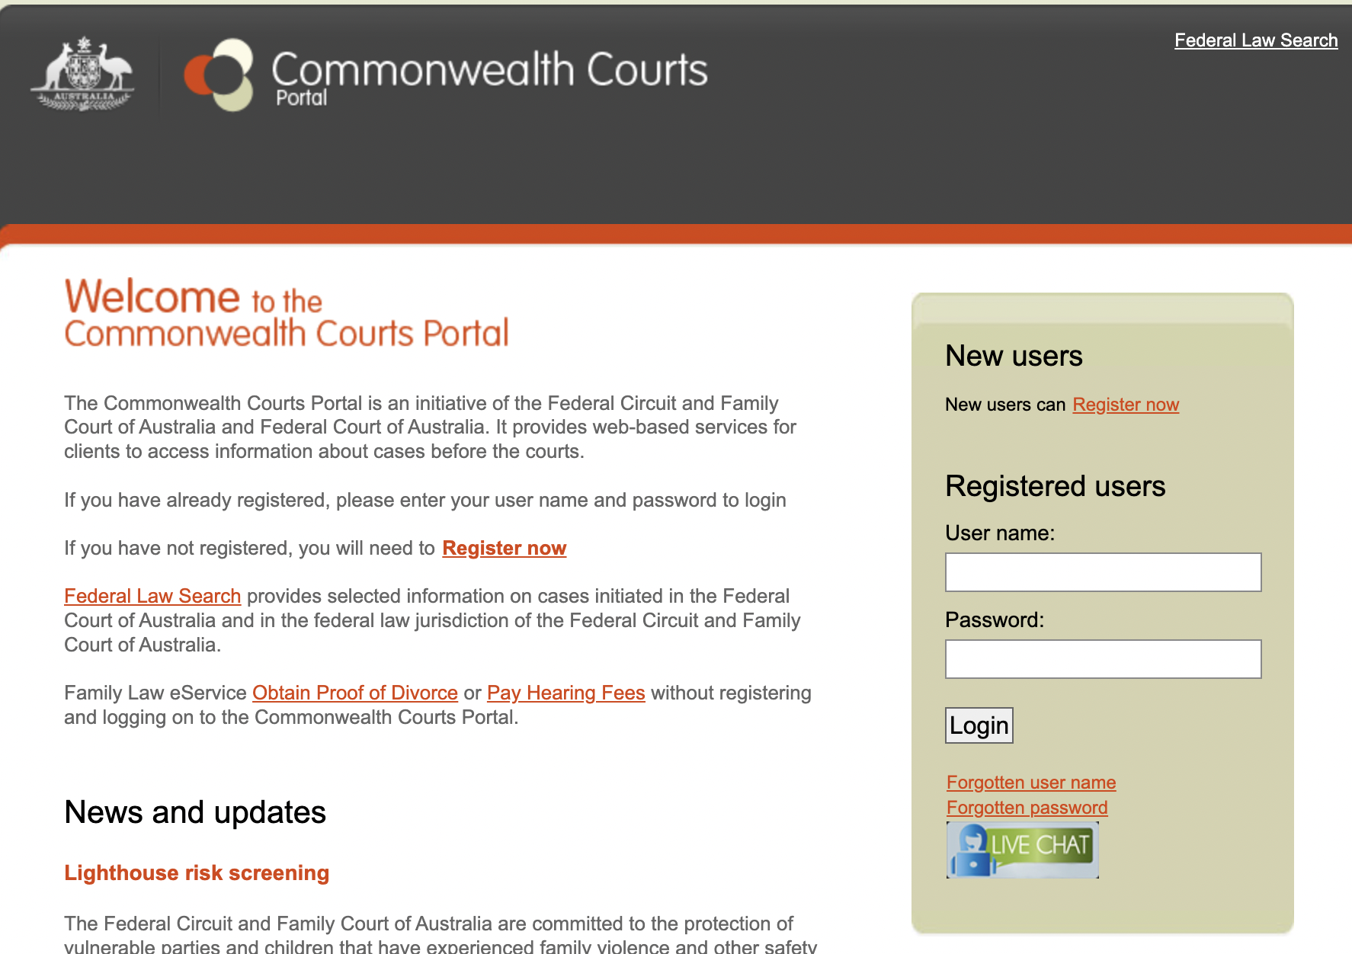
Go to the Commonwealth Courts (“Comcourts”) Portal via www.comcourts.gov.au.
If you do not have a Comcourts account press “Register now”.
The next page will ask for your details and ask you to create a username and password for Comcourts.

Slide 5
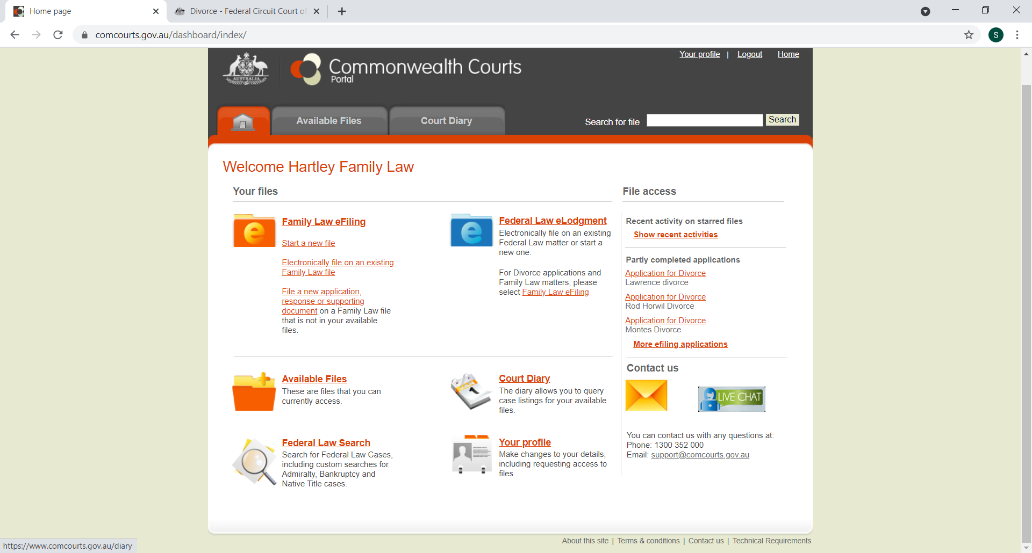
Once you have created an account, login to Comcourts.
Click “Start a new file”.
The next page will ask you to confirm that you are filing on your own behalf.
The next page is about eFiling and will ask you to confirm that you have read and understood the eFiling obligations.

Slide 6
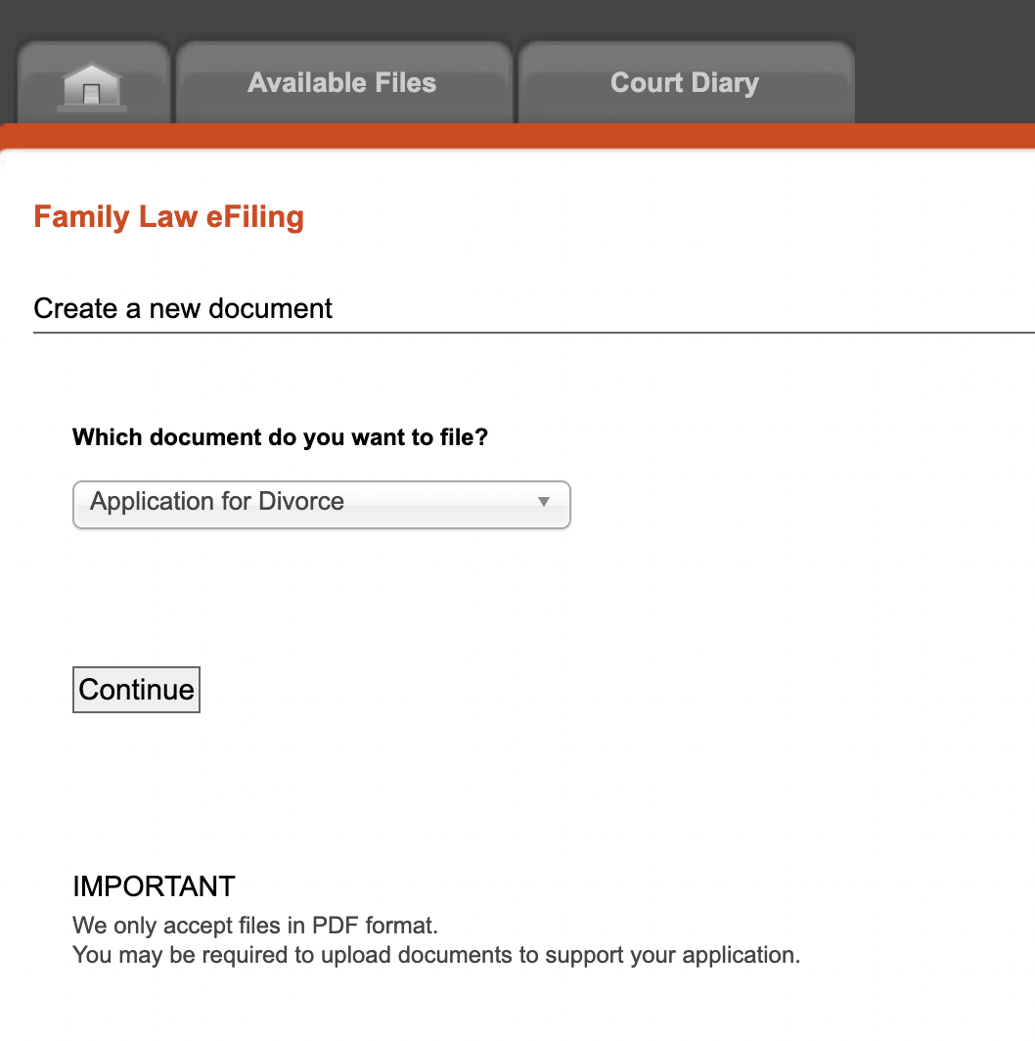
When asked “what document do you want to file?” nominate “Application for divorce”.
Then click “Continue”.
The next page you will be taken to will ask what Title and Description you would like to give this document. You should use a Title and Description that will enable you to identify your document if you need to return and complete it.

Slide 7
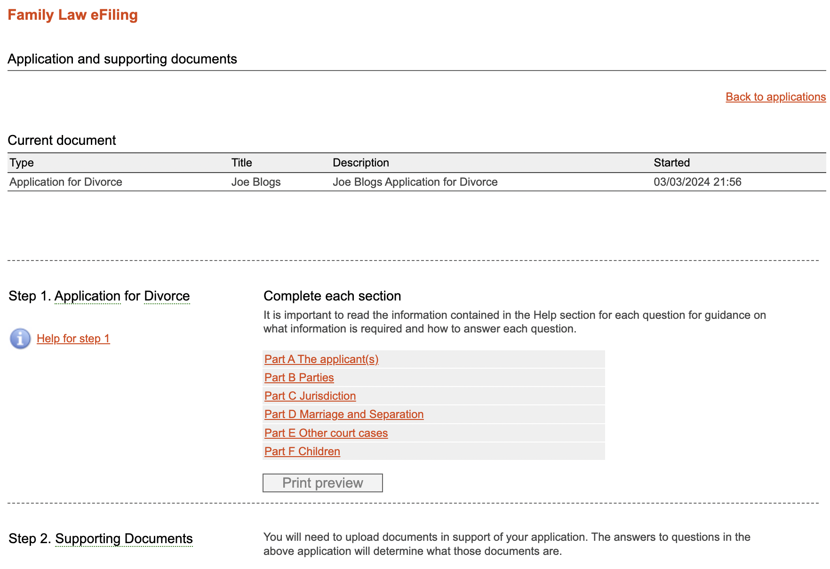
8. Click “Part A The applicant(s)”. Part A is the first section you will complete and asks about who the parties are.

Slide 8
Part A, question 1 – as this is a joint application tick “Party 1 & Party 2 together (joint)”. It doesn’t matter whether you put yourself as Party 1 or Party 2.
If you and the other party both qualify for a fee reduction (ie. You both hold certain government concession cards) then the filing fee can be reduced. To request a fee reduction, you will need to provide evidence that you both qualify.
Part A, question 2 – for a joint application neither party is required to attend. Therefore, you can tick “no” for both if you both don’t wish to attend.
At the bottom of the page tick “validate” then “save”. Then click “next”.

Slide 9
Party B asks for more details about you and the other party.
Part B, questions 3 and 4 – make sure you put both parties’ names (including middle names) as they are currently known by.
Part B, question 7 – if you or the other party are a more recent arrival, the date you started living in Australia can be found on your passport. If you or the other party came to Australia many years ago and cannot remember the exact date, an approximate date is fine.
Part B, question 10 – you can’t see it here but it asks what the address for service is. You can use your residential address or any address where you are satisfied that you will receive documents.
Please note, the address for service must be in Australia when you are filing online. Otherwise, you cannot complete the Application.
At the bottom of the page tick “validate” then “save”. Then click “next”.

Slide 10
Part C asks about Jurisdiction. The purpose being to determine if the Court can hear the Application.
Even if some of the answers to these questions at 11 are “no” the Application is still valid as long as you or the other party either regard Australia as home and intend to live indefinitely in Australia or are an Australian citizen or resident or ordinarily live in Australia and have done so for 12 months immediately before filing for divorce.
At the bottom of the page tick “validate” then “save”. Then click “next”.

Slide 11
Part D is about the marriage and separation. Parties cannot apply for a divorce unless 12 months has passed since separation. Note: you cannot apply on the day that marks 12 months, you must apply on the following day.
Part D, question 12 – make sure the date and place of marriage matches the marriage certificate – this is the second most common error on divorce applications.
Part D, question 13 – you must write the names of both parties exactly as they appear on the marriage certificate. The most common error on divorce applications is not writing down the names of either of the parties correctly based on what it says on the marriage certificate.
Part D, question 14 – if there is a dispute about the date of separation the safest thing to do is to just wait until 12 months after the later date. If this is not an option, you will need to file an Affidavit demonstrating that you have been separated for 12 months.

Slide 12
Part D contd. Question 16 – if you and the other party separated under the same roof, you will need to provide the dates when this occurred. If this occurred multiple times, click “Add Period” to add all the dates this occurred. You and the other party will also need to each file an Affidavit explaining that you lived under the same roof but were separated.
Part D, question 17 – if you and the other party reconciled, add the period that this occurred. If you and the other party reconciled for 3 or more months, then the time limit for applying for a divorce re-sets. i.e. the 12 months start again from the date of the second separation.
Part D, question 18 – the law requires an “irretrievable breakdown of a marriage” to grant a divorce. If the answer to Question 18 is yes, then you cannot apply for a divorce.
Part D, question 19 – if parties have been married for less than 2 years at the date of applying for a divorce, they will need to attend counselling. If parties have not attended counselling, they will need to file an Affidavit seeking permission from the Court to apply for a divorce.
At the bottom of the page tick “validate” then “save”. Then click “next”.

Slide 13
Part E is about other court cases.
If your matter is presently before the Court either about parenting, property, family violence, child support and/or maintenance, then complete Question 20. You will be asked for a summary of the case. Just be brief and say for example “Family Law – parenting and property matters”. If there are a couple of cases e.g. in the FCFCOA and maybe a domestic violence application in the Magistrates Court then you will need to include that by clicking “Add Case”.
If you have filed consent orders, a Binding Financial Agreement (“BFA”), a Binding Child Support Agreement (“BCSA”) or signed a parenting plan then complete Question 21. Give very brief details (e.g. BFA regarding property matters entered into).
At the bottom of the page tick “validate” then “save”. Then click “next”.

Slide 14
Part F is about any children of the relationship under 18 – do not include children over 18.
If there are any children of the relationship or children treated as members of your family under 18, click “add child’s details” and then proceed to complete their information at Questions 23-29.
A sample response for Question 28 is included here (note: if there are orders or a parenting plan in place then use that information generally to complete Question 28 regarding “time”. If there is a BCSA in place then mention that at Question 28 regarding “Financial Support”).
Question 29 – an example where parents may be making changes to the current arrangement is if the child’s care is the subject of current proceedings. If that is the case, briefly explain that this is what is happening here.
At the bottom of the page tick “validate” then “save”. Then click “next”.

Slide 15
Part F is the final section before you are taken to the filing page. You should review the Application by clicking “Print Preview” and saving the PDF that is generated.
If you are satisfied with the Application, send it to the other party for their review as well.
At Step 2, upload the Marriage Certificate and any other documents that Step 2 asks you to upload (this will auto generate based on your answers under each Part).
If you have had to prepare Affidavits in response to any question, these are filed after the Application for Divorce is filed.
At Step 3 – DO NOT LOCK AND CONTINUE UNTIL ALL PARTIES TO THE JOINT APPLICATION HAVE APPROVED THE DRAFT OTHERWISE YOU HAVE TO WRITE TO THE COURT TO ASK THEM TO UNLOCK IT FOR YOU TO BE ABLE TO MAKE ANY CHANGES.
Once the Application is finalised, then click “Lock and Continue”.
From here you will be able to download and save the Application. You and the other party will then need to swear and sign the Affidavit of eFiling Application (Divorce) and upload it.
Once you have paid for the Application and submitted it, you will be able to pick the Divorce hearing date.
Make sure you then email the other party the completed Application and let them know the Divorce hearing date.

Slide 16
PART B
Sole Application for Divorce

Slide 17
Go to the Commonwealth Courts (“Comcourts”) Portal via www.comcourts.gov.au.
If you do not have a Comcourts account press “Register now”.
The next page will ask for your details and ask you to create a username and password for Comcourts.

Slide 18
Once you have created an account, login to Comcourts.
Click “Start a new file”.
The next page will ask you to confirm that you are filing on your own behalf.
The next page is about eFiling and will ask you to confirm that you have read and understood the eFiling obligations

Slide 19
8. When asked “what document do you want to file?” nominate “Application for divorce”.
Then click “Continue”.
The next page you will be taken to will ask what Title and Description you would like to give this document. You should use a Title and Description that will enable you to identify your document if you need to return and complete it.

Slide 20
11. Click “Part A The applicant(s)”. Part A is the first section you will complete and asks about who the parties are.

Slide 21
12. Part A, question 1 – as this is a sole application tick “Party 1” only.
13. If you qualify for a fee reduction (ie. You hold certain government concession cards) then the filing fee can be reduced. To request a fee reduction, you will need to provide evidence that you qualify such as scanned copies of concession cards and other documents.
14. Part A, question 2 – if there is a child of the marriage under 18, you must attend the hearing and click “yes”. If there are no children under 18, you are not required to attend the hearing and can tick “no” if you don’t wish to attend.
15. At the bottom of the page tick “validate” then “save”. Then click “next”.

Slide 22
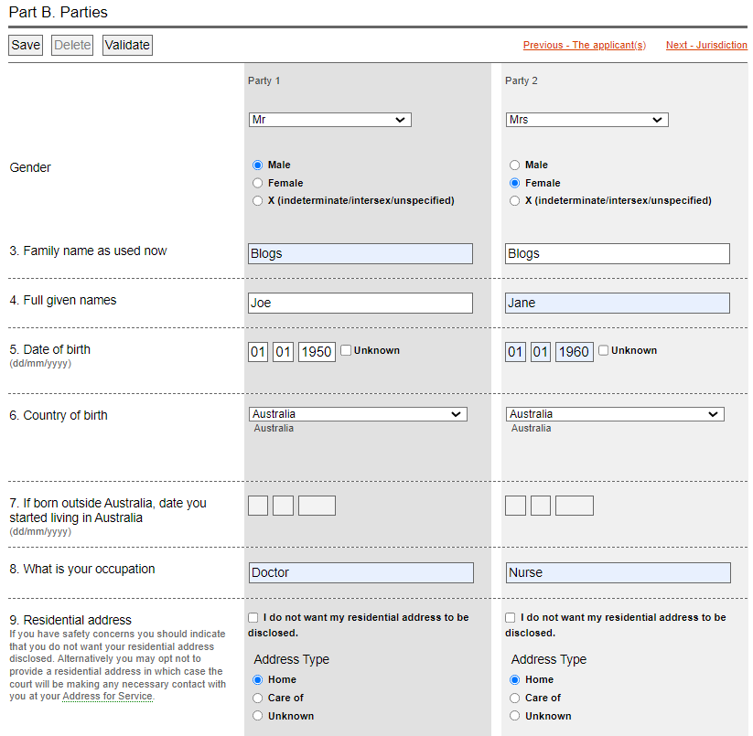
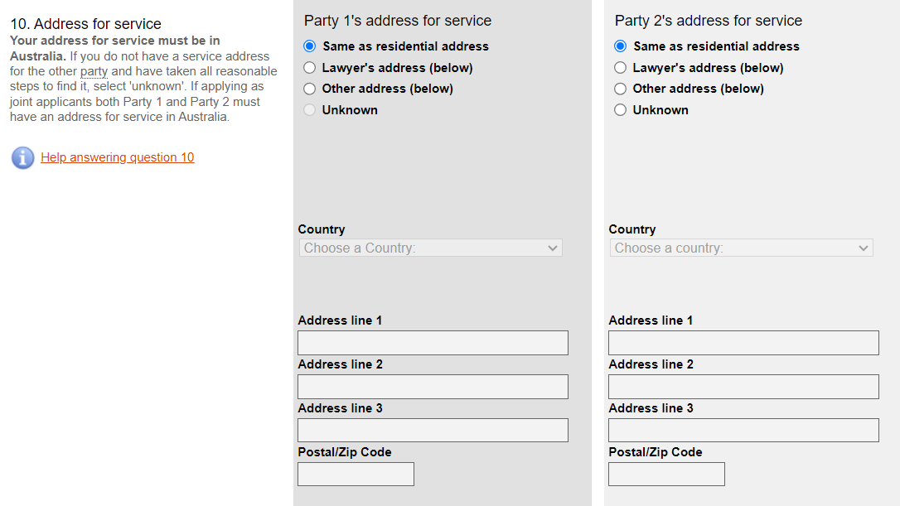
Part B asks for more details about you and the other party.
Part B, questions 3 and 4 – make sure you put both parties’ names (including middle names) as they are currently known by.
Part B, question 7 – if you or the other party are a more recent arrival, the date you started living in Australia can be found on your passport. If you or the other party came to Australia many years ago and cannot remember the exact date, an approximate date is fine.
Part B, question 10 – asks for the address for service. You can use the other party’s and your residential address or any address where you are satisfied that the other party and you will receive documents.
Please note, the address for service must be in Australia when you are filing online. Otherwise, you cannot complete the Application.
At the bottom of the page tick “validate” then “save”. Then click “next”.

Slide 23
Part C asks about Jurisdiction. The purpose being to determine if the Court can even hear the Application.
Even if some of the answers to these questions at 11 are “no” the Application is still valid as long as you or the other party either regard Australia as home and intend to live indefinitely in Australia, or are an Australian citizen or resident or ordinarily live in Australia and have done so for 12 months immediately before filing for divorce.
The only difference between the joint and sole applications for this section is you cannot answer Question 11(a) on behalf of the other side.
At the bottom of the page tick “validate” then “save”. Then click “next”.

Slide 24
Part D is about the marriage and separation. Parties cannot apply for a divorce unless 12 months have passed since separation. Note: you cannot apply on the day that marks 12 months, you must apply on the following day.
Part D, question 12 – make sure the date and place of marriage matches the marriage certificate – this is the second most common error on divorce applications.
Part D, question 13 – you must write the names of both parties exactly as they appear on the marriage certificate. The most common error on divorce applications is not writing down the names of either of the parties correctly based on what it says on the marriage certificate.
Part D, question 14 – if you already know there is a dispute about the date of separation, the safest thing to do is to just wait until 12 months after the later date. This saves the need for a hearing about the separate date. If the other party does not agree with the date of separation, then they will need to file a “Response” to the Divorce Application.

Slide 25
30. Part D contd. Question 16 – if you and the other party separated under the same roof, you will need to provide the dates when this occurred. If this occurred multiple times, click “Add Period” to add all the dates this occurred. You will need to file an Affidavit explaining that you and the other party lived under the same roof but were separated. You should also file an affidavit by an independent person such as a family member, friend or neighbour (if possible) to support your claim that you separated under the same roof.
31. Part D, question 17 – if you and the other party reconciled, add the period that this occurred. If you and the other party reconciled for 3 or more months, then the time limit for applying for a divorce re-sets. i.e. the 12 months start again from the date of the second separation.
32. Part D, question 18 – the law requires an “irretrievable breakdown of a marriage” to grant a divorce. If the answer to Question 18 is yes, then you cannot apply for a divorce.
33. Part D, question 19 – if parties have been married for less than 2 years at the date of applying for a divorce, they will need to attend counselling. If parties have not attended counselling, they will need to file an Affidavit seeking permission from the Court to apply for a divorce.
34. At the bottom of the page tick “validate” then “save”. Then click “next”.

Slide 26
35. Part E is about other court cases.
36. If your matter is presently before the Court either about parenting, property, family violence, child support and/or maintenance, then complete Question 20. You will be asked for a summary of the case. Just be brief and say for example “Family Law – parenting and property matters”. If there are a couple of cases e.g. in the FCFCOA and maybe a domestic violence application in the Magistrates Court then you will need to include that by clicking “Add Case”.
37. If you have filed consent orders, a Binding Financial Agreement (“BFA”), a Binding Child Support Agreement (“BCSA”) or signed a parenting plan then complete Question 21. Give very brief details (e.g. BFA regarding property matters entered into).
38. At the bottom of the page tick “validate” then “save”. Then click “next”.

Slide 27
39. Part F is about any children of the relationship under 18 – do not include children over 18.
40. If there are any children of the relationship or children treated as members of your family under 18, click “add child’s details” and then proceed to complete their information at Questions 23-29.
41. A sample response for Question 28 is included here (note: if there are orders in place or a parenting plan then use that information generally to complete Question 28 re “time”. If there is a BCSA in place then mention that at Question 28 re “Financial Support”).
42. Question 29 – an example where parents may be making changes to the current arrangement is if the child’s care is the subject of current proceedings. If that is the case, briefly explain that this is what is happening here.
43. At the bottom of the page tick “validate” then “save”. Then click “next”.

Slide 28
44. Part F is the final section before you are taken to the filing page. You should review the Application by clicking “Print Preview” and saving the PDF that is generated.
45. At Step 2, upload the Marriage Certificate and any other documents that Step 2 asks you to upload (this will auto generate based on your answers under each Part).
46. If you have had to prepare Affidavits in response to any question, these are filed after the Application for Divorce is filed.
47. At Step 3 – DO NOT LOCK AND CONTINUE UNTIL YOU HAVE PREVIEWED THE DRAFT AND ENSURED THAT ALL THE INFORMATION IS CORRECT. OTHERWISE, YOU HAVE TO WRITE TO THE COURT TO ASK THEM TO UNLOCK IT FOR YOU TO BE ABLE TO MAKE ANY CHANGES.
48. Once the Application is finalised, then click “Lock and Continue”.
49. From here you will be able to download and save the Application. You will then need to swear and sign the Affidavit of eFiling Application (Divorce) and upload it.
50. Once you have paid for the Application and submitted it, you will be able to pick the Divorce hearing date (don’t be surprised if it is very far in the future).
51. Once you have filed the Application, you will need to serve the other party – see the How To Guide about this as well as to obtain the template letters etc.

Slide 29
How to Serve a Sole Application for Divorce
There are a number of ways which you can serve a Sole Application for Divorce on the other party.
Serving the other party’s lawyers
If the other party has a lawyer, you can write to their lawyer and ask whether they hold instructions to accept service.
If their lawyer states that they hold instructions to accept service, then serve the application on their lawyer and ask them to sign the Acknowledgement of Service form.
Serving the documents by hand
You cannot serve the application on the other party yourself.
You must arrange for a person who is at least 18 years of age or over to serve the application on the other party. The ‘server’ can be a family member, friend or professional process server.
The server will then need to complete an Affidavit of Service by hand and, if signed by the other party, attach the original signed Acknowledgement of Service.

Slide 30
Serving the documents by post
This can be done by posting the document to the other party’s address.
However, you should only attempt service by post if you know that the other party will sign and return the Acknowledgement of service (Divorce) to you.
If you attempt service by post and do not receive the signed Acknowledgement of service (divorce), you may need to arrange service by hand.

Slide 31
Time Limits for Service
The following time limits apply for the service of Divorce Applications:
If the other side is in Australia, the documents must be served at least 28 days before the court hearing; or
If the other side is overseas, the documents must be served at least 42 days before the court hearing.

